Slide 1
Concerns While Testing
Christian M. Adriano

Slide 2
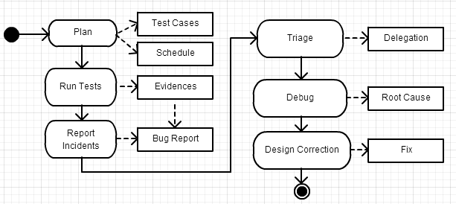
Macro-Process Visual Representation

Slide 3
Process
Activity | Description | Role | Questions
Plan | Reading Use Cases Understanding Dependencies Writing Test Cases Setup Testing Environment Define Test Cycles | Tester | What are the inputs and outputs expected? What is the sequence of use cases? What is the code dependency among test cases (for regression test)?
Run Tests | Run Tests Collect Evidences | Tester | Is it a defect or was the environment? Is it a feature or a bug? Where is the log file?
Report Incidences | Catalog Bugs (Feature, Severity, Blocking) Document Evidences | Tester | How severe? Does it block other tests? How to describe the actions I took to get to this bug?
Bug Triage | Verify Missing Information Clarify Report Define Ownership Assign Fix to Target Build | Developer Testers Req Eng | What does it mean? Do you have the stacktrace for this incident? Who knows best this feature? Could we schedule for next build?
Debug | Reproduce Bug Trace Root Cause | Developer | What if you used a different setup? Does it happen because of the missing spaces?
Design Correction | Discuss, Design, Approve Solutions | Developer | Could we separate this behavior in two different methods?

Slide 4
On-going Activities
Resolution
After inactivity, after workaround, after new buil
Status Enquiry
Progress, target version, workaround, impact among bugs, resolution and priority
Process
Authority, Responsability, Permissions

Slide 5
Triage Inputs and Outputs
Delegation
Incidents
Triage
Build Assignment
Bug
Priorities
Fix
Categorization
Notes:
Delegation can be of Incidence to investigate, Bug to debug, Bugfix to implement.

Slide 6
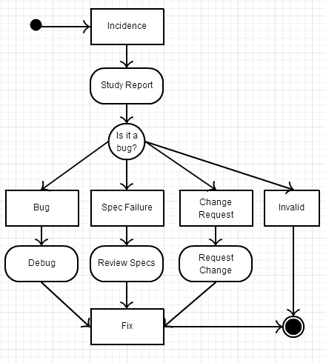
Bug Life Cycle

